Slide 1

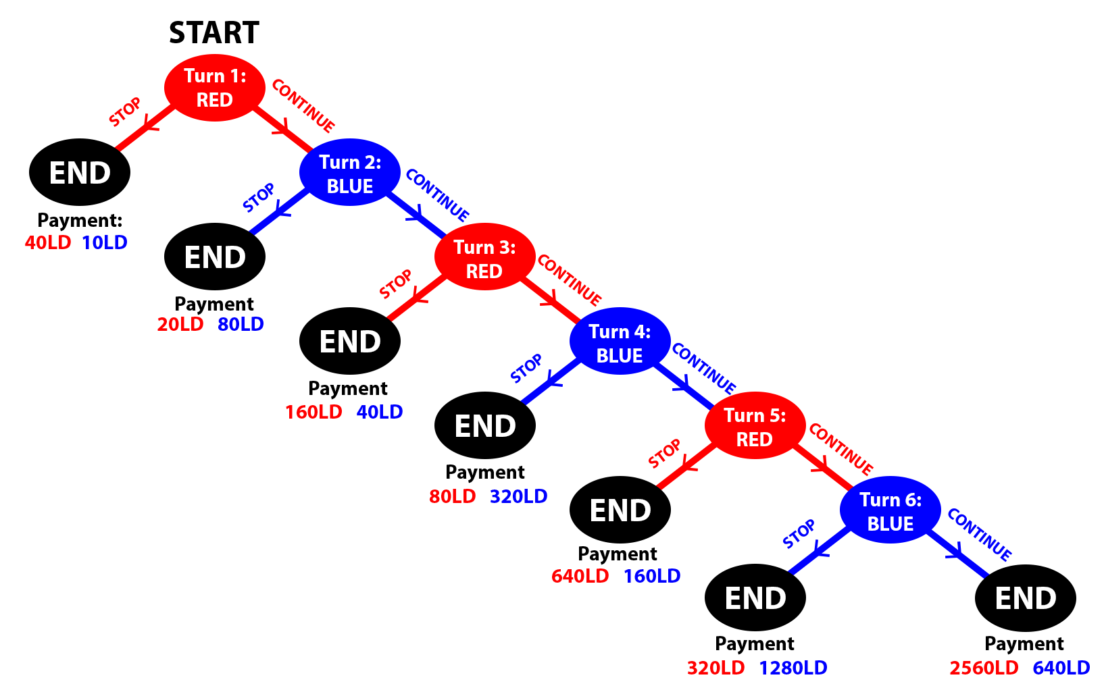

Perceptions of Opponent’s IQ and Rational Play Hariaksha Gunda
Advisor: Dr. Michael Price
Department of Economics, Finance, and Legal Studies
ABSTRACT
THE CENTIPEDE GAME
MOTIVE ELICITATION
Human decision making plays an integral role in the world around us. Many models for it rely on assumptions of rational behavior. Specifically, backwards induction solutions assume sequential rationality: that people behave rationally and strategically at every decision point and consider this common knowledge among everyone. However, humans often break from this. Our research will investigate one relatively unexplored aspect for why by examining the role that an individual’s perception of their opponent’s intelligence has on their thought processes and decisions. This will be measured quantitatively through a series of 2 player centipede game variations as well as qualitatively through a survey asking about the players motivations. The central hypothesis is that being told their opponent’s IQ will lead to a difference in both their decisions and thought processes. In full, this project will yield a deeper understanding of the effects that someone’s perception of others’ intelligence has on their decisions and reasoning. This can then be applied to better understand and shape a myriad of real-world interactions.
Frequently studied example of people breaking from subgame perfection. Perfect example of the paradoxical nature of backwards induction and rationality:
At turn 6, BLUE’s best choice is to STOP
This means at turn 5, RED’s best choice is to STOP
...Continues this logic to turn 1…
RED’s best choice is to stop turn 1
The subgame perfect equilibrium (which assumes sequential rationality) is ending turn 1.
Humans do not behave this way and receive on average more money because of it (deviation is a Pareto improvement over equilibrium). The game highlights the paradoxical nature of rationality since higher intelligence individuals deviate more from rational behavior and received more money from this “irrational” behavior. *cite*
Eliciting individual's true motivations is a significant challenge in game theory research as isolating individual motivations and traits is difficult from a single experiment. Our research takes several approaches to elicit participant’s true motivations:
Using 2 variant centipede game conditions to control for and isolate several contributing motivations
Incorporating a qualitative aspect by directly asking participants their thought processes instead of only extrapolating from quantitative results.
Figure 1: Centipede Game
HYPOTHESES
“If this is rationality, they want none of it” – Robert Aumann²
Having knowledge of their opponent’s IQ will affect an individual’s choices and thought processes.
This effect will be different for individuals who are high versus low IQ.
There will be a decrease in deviation in the constant sum game as altruistic motives are controlled for.
There will not be a significant difference in deviation between the exponential and linear growth game.
Players will reason to a greater depth if they are told their opponent is higher IQ
BACKGROUND
EXPERIMENTAL DESIGN
Backwards Induction:
In a sequential perfect information game (ex. Chess), you can use backwards induction to determine the best possible choice under subgame perfection.
Assumptions:
Sequential rationality
In other words, each player will strategically maximize their reward at any possible choice point, and they assume this is common knowledge between the players
Human Behavior:
Humans don’t behave this way
Real World examples: Entry deterrence, blackmail
Experimental evidence: Chainstore and Centipede Games¹
RESEARCH QUESTION
How does a participant’s perception of their opponent’s IQ affect their own choices?
TIDE (The Interactive Decision Experiment) Lab
Undergraduates recruited with monetary incentive
Interact anonymously on computers using z-Tree software
Told their opponent’s IQ
4th quartile
3rd quartile
Participant Pool
Not told their opponent’s IQ
2nd quartile
1st quartile
FUTURE STEPS
Figure 2: Experimental groups
Raven’s IQ Test
Centipede Games
Qualitative Questions
Reasoning/ Attitude
The next steps are:
Obtaining IRB approval
Code the experiment
Run the experiment
Analyze the data
MOTIVATION
From the personal interactions each of us encounter daily to the geopolitical interactions between nations, human decision making plays an integral role in the world around us. Past research has shown the importance of someone’s perception of their opponent in mediating their deviation from rational behavior¹. This research addresses some minimally explored questions regarding the role that perceptions of IQ have on how and why humans deviate from rationality. Furthermore, our effort to include qualitative measures will aim to fill a gap in the current literature³ and help provide a fuller understand of human thought processes and decision making, which can then be applied to a myriad of real-world interactions.
Raven’s test is a standard metric for IQ that consists of a set of matching puzzles
Participants will not be told it is a metric for IQ until afterwards.
They will not be told their own results.
3 different variants of the centipede game will be played in a randomized order:
Standard exponential increasing pot
Linearly increasing pot
Constant sum pot
Randomly paired with different opponent for each game. One group will be told IQ quartile of their opponent.
Survey questions about thought process and reasoning the participant’s used in each of the games.
Examples:
Please describe the decision-making process you used in Game 1?
Did learning the IQ of the other participant effect the way you approached your strategy?
Reasoning test to baseline the participants ability to reason through a backward induction problem.
Short social attitudes test to measure other-regarding preferences
Demographic data is automatically collected by TIDE Lab
REFERENCES
[1] Yaden, D. B., Giorgi, S., Jordan, M., Buffone, A., Eichstaedt, J. C., Schwartz, H. A., Ungar, L., & Bloom, P. (2024). Characterizing empathy and compassion using computational linguistic analysis. Emotion, 24(1), 106–115. https://doi-org.libdata.lib.ua.edu/10.1037/emo0001205.supp (Supplemental)
[2] Baek, Y. M., Ihm, J., & Kang, C. H. (2023). Does mission concreteness make a difference in nonprofit performance? Automated text analysis approach to the importance of concrete mission statements. Nonprofit Management & Leadership, 34(2), 409–431. https://doi-org.libdata.lib.ua.edu/10.1002/nml.21570
[3] Ward, B. (2023). Relationship Between Mission Statement Components and ROA: A Study of Small-Cap Financial Firms. IUP Journal of Business Strategy, 20(4), 5–19.

